Slide 1
Creative Arts – Dance
Year 8

Slide 2
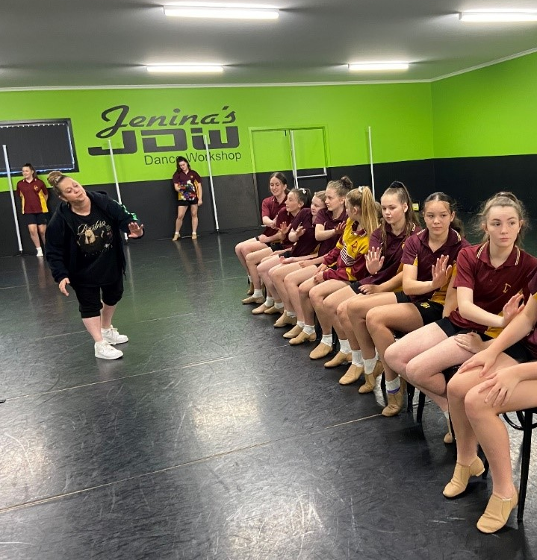
Dance
Our partnership with Jenina’s Dance Workshop, one of Hobart’s premier dance studios, ensures that our students have access to the best instructors and facilities possible. Expert dance teachers share their knowledge, giving our students an excellent, professional dance experience. The course caters for experienced dancers and those taking the subject for the first time.

Slide 3
What do you do?
Learn about the elements of Dance – the building blocks which come together to create meaningful performances.
How to warm-up, stretches, developing flexibility, strength, coordination.
Introduction to dance techniques, including Classical, Ballet, Contemporary, Jazz, Hip-Hop and Lyrical.
All Dance students present their work at the Southern Tasmanian Dance Eisteddfod and Showcase events at the College.

Slide 4
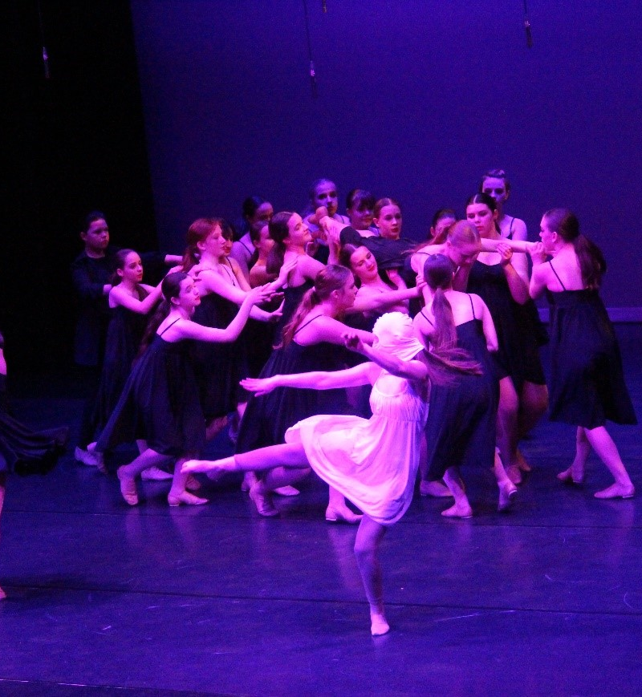
What you need?
Sports uniform.
Jazz shoes.
Energy and enthusiasm.

Slide 5
Find out more…
Please feel free to contact Mr Mike O’Brien, Head of Creative Arts, at mobrien@dominic.tas.edu.au

